Slide 1
Impact of AI in Student Life: 2026 Insights
Analyzing Trends, Usage Patterns, and Ethical Risks in Higher Education
Presenter: [Gautam ,Amit ,Shivam]

Slide 2
Project Objective
Purpose: To visualize the rapid integration of Generative AI within student academic workflows.
Key Goals:
Track the adoption rate from 2024 to 2026.
Identify primary use cases ranging from concept explanation to wellbeing.
Highlight the institutional gap between student usage and formal policy/training.
Assess ethical risks, including the "Shadow Literacy" divide and fear of false accusations.

Slide 3
📌 Problem Statement & Objectives
Problem Statement
Rapid growth of Generative AI in student life (95% adoption by 2026)
Gap between student usage and institutional readiness
Lack of formal training, policies, and AI literacy
Rising concerns:
Ethical issues (plagiarism, misuse)
Fear of false accusations
“Shadow Literacy Divide” (skill & access gap)

Slide 4

Technical Architecture (Libraries)
To build this interactive analytical tool, the following R libraries were utilized:
shiny & shinydashboard: Core framework for the web interface and structured layout.
plotly: For high-quality, interactive Javascript-based visualizations.
tidyverse: Used for data manipulation, cleaning, and ggplot2 base logic.
pacman: For streamlined dependency management and package loading.
DT & shinycssloaders: For interactive data tables and smooth loading animations.

Slide 5
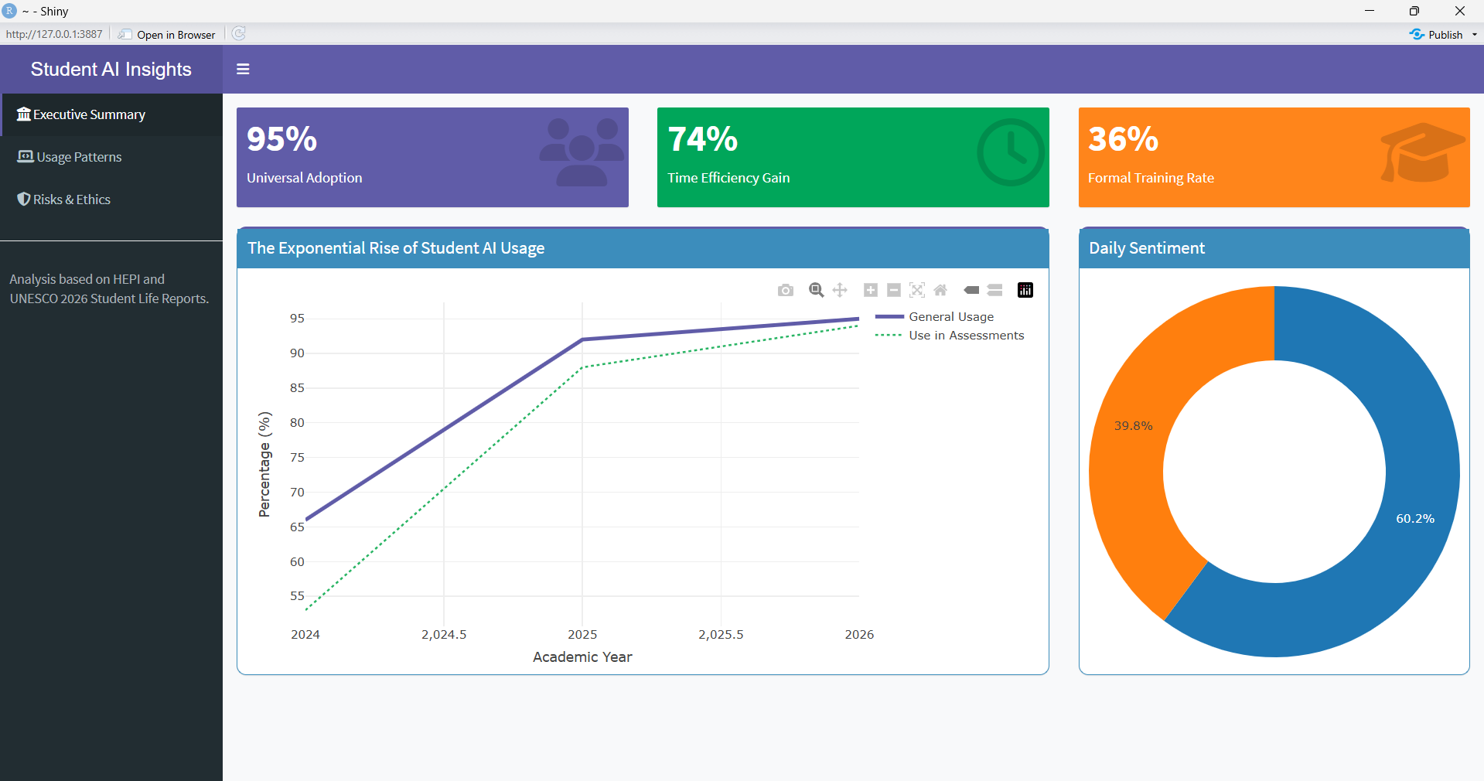
Dashboard Overview
Key Metrics Displayed: * 95% Universal Adoption.
74% Time Efficiency Gain.
36% Formal Training Rate (indicating a significant literacy gap).

Slide 6
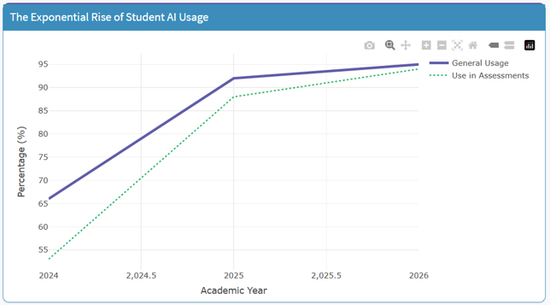
The Rise of AI Adoption (Graph Analysis)
Exponential Growth: General usage jumped from 66% in 2024 to 95% in 2026.
Assessment Integration: Use of AI specifically for assessments followed a similar trajectory, reaching 94%.
Insight: AI is no longer a "niche tool"; it is now a fundamental utility for nearly every student.
Adoption plot

Slide 7
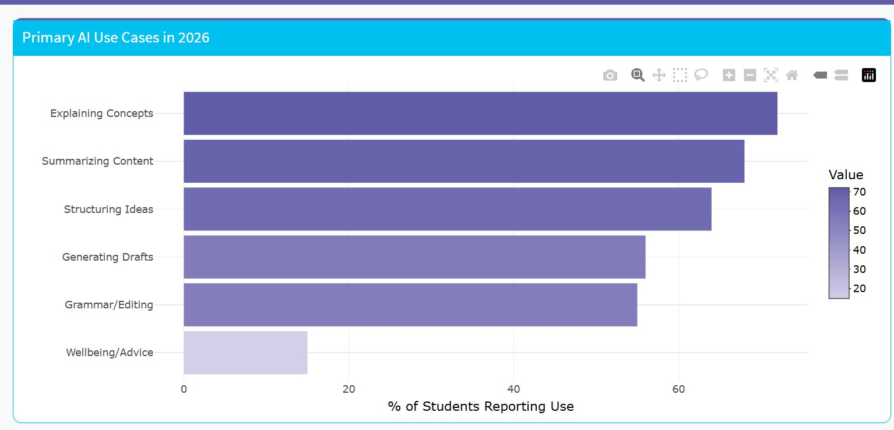
Primary Use Cases & Wellbeing
Top Academic Tasks: Explaining concepts (72%) and Summarizing content (68%) lead the way.
Emerging Tools: * Companion Bots: 15% of students use AI to address loneliness.
24/7 Tutors: AI is filling the gap for active recall and spaced repetition.
Transcription: Shifting student focus from note-taking to active engagement.

Slide 8
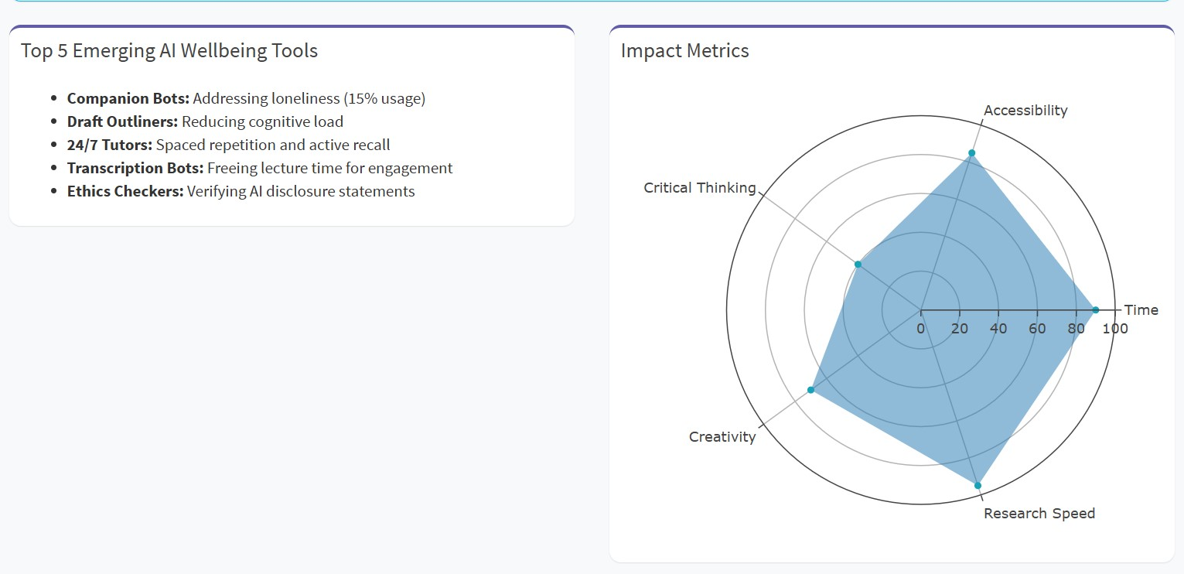

Slide 9
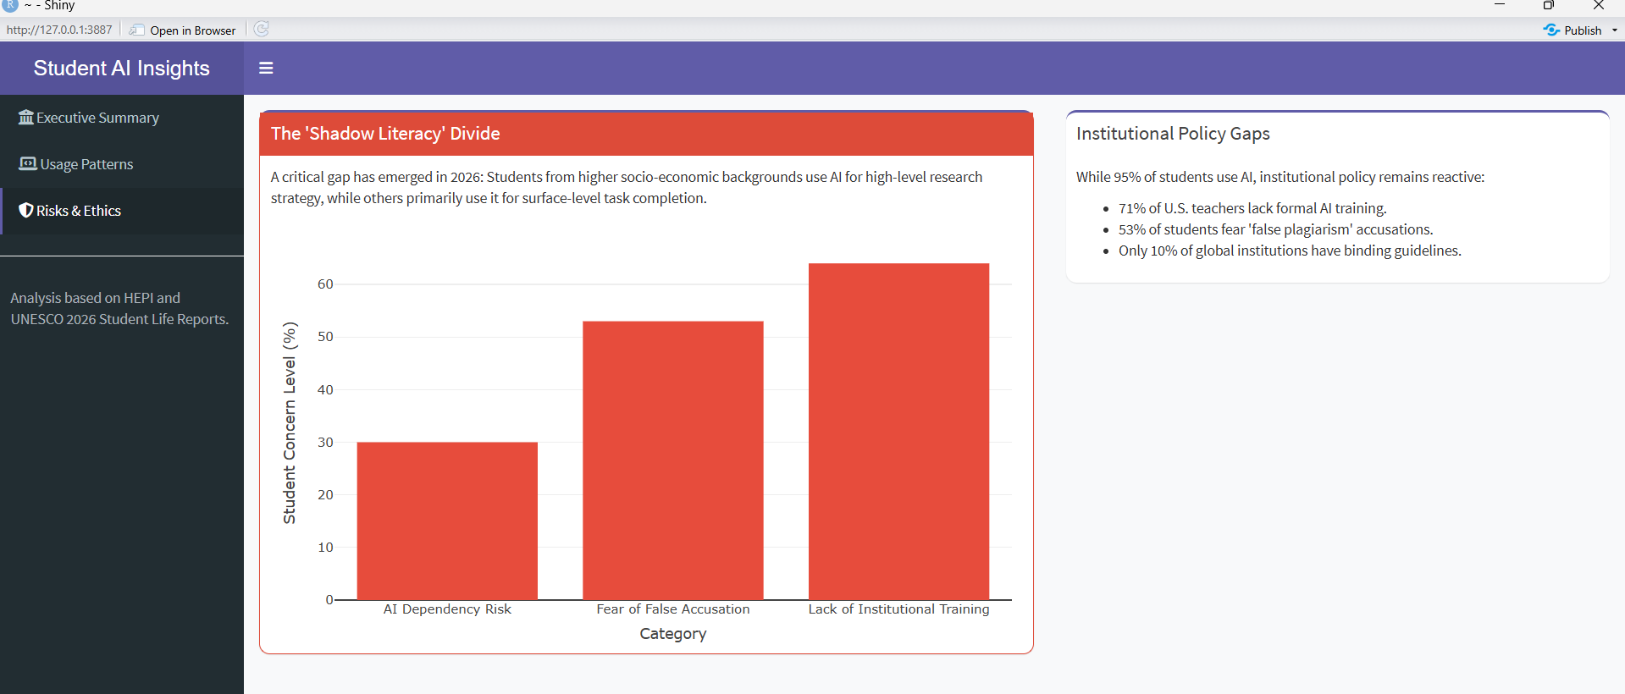
Risks & Ethical Gaps
The Shadow Literacy Divide: A new socio-economic gap where high-income students use AI for "strategy," while others use it for "completion."
Major Concerns:
Lack of Training: 64% of students feel institutions haven't provided enough guidance.
Fear of False Accusations: 53% of students worry about being wrongly flagged for plagiarism.
Policy Lag: Only 10% of global institutions have binding AI guidelines

Slide 10
Key Results
Efficiency: Students report a 74% increase in time efficiency, particularly in research and drafting.
Accessibility: AI has leveled the playing field for accessibility but created a new "skills gap" in high-level AI prompt strategy.
Sentiment: While 60.2% of daily sentiment is positive regarding efficiency, a significant 39.8% remains anxious about institutional trust and dependency.

Slide 11
Conclusion
Summary: By 2026, AI adoption is near-universal (95%), but formal education is struggling to keep pace (36% training rate).
Call to Action: * Institutions must move from reactive to proactive policy-making.
Focus should shift from "detecting AI" to "teaching AI literacy."
Reducing the "Fear of False Accusations" is critical for student mental health and academic integrity.

Slide 12
Thank you

